Slide 1


Event
Management System
Presented by-
Modabbir Mohammad Mansur
Ashab Uddin
Rukonuzzaman Topu
Presented to-
Wahia Tasnim
Lecturer Dept. Of CSE

Slide 2
01
INTRODUCTION
02
MOTIVATION
03
AIMS
CONTENTS
04
TOOLS & TECHNOLOGIES
05
USE & LOOK
06
APLICATIONS & LIMITATIONS
07
CONCLUSION

Slide 3

Introduction
Event Management System is a comprehensive platform designed to streamline the planning, coordination, and execution of events. It offers features such as event scheduling, attendee management, resource allocation, and real-time updates, ensuring seamless organization and enhanced user experience for both organizers and participants

Slide 4

MOTIVATIONS
To reduce pen-paper uses
To make event managing easier
To improve our skill

Slide 5

AMIS
Create a proper Event
Management System
Make user friendly

Slide 6

TOOLS AND TECHNOLOGIES
NetBeans IDE
Visual Studio Code
JDK

Slide 7

EVENT CREATE
To create event we need to give some user input like
event name, date, and capacity.

Slide 8
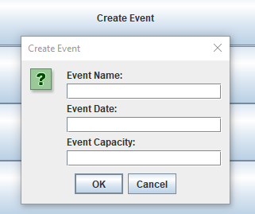
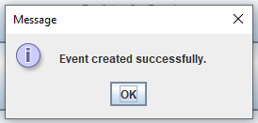
EVENT CREATE

Slide 9
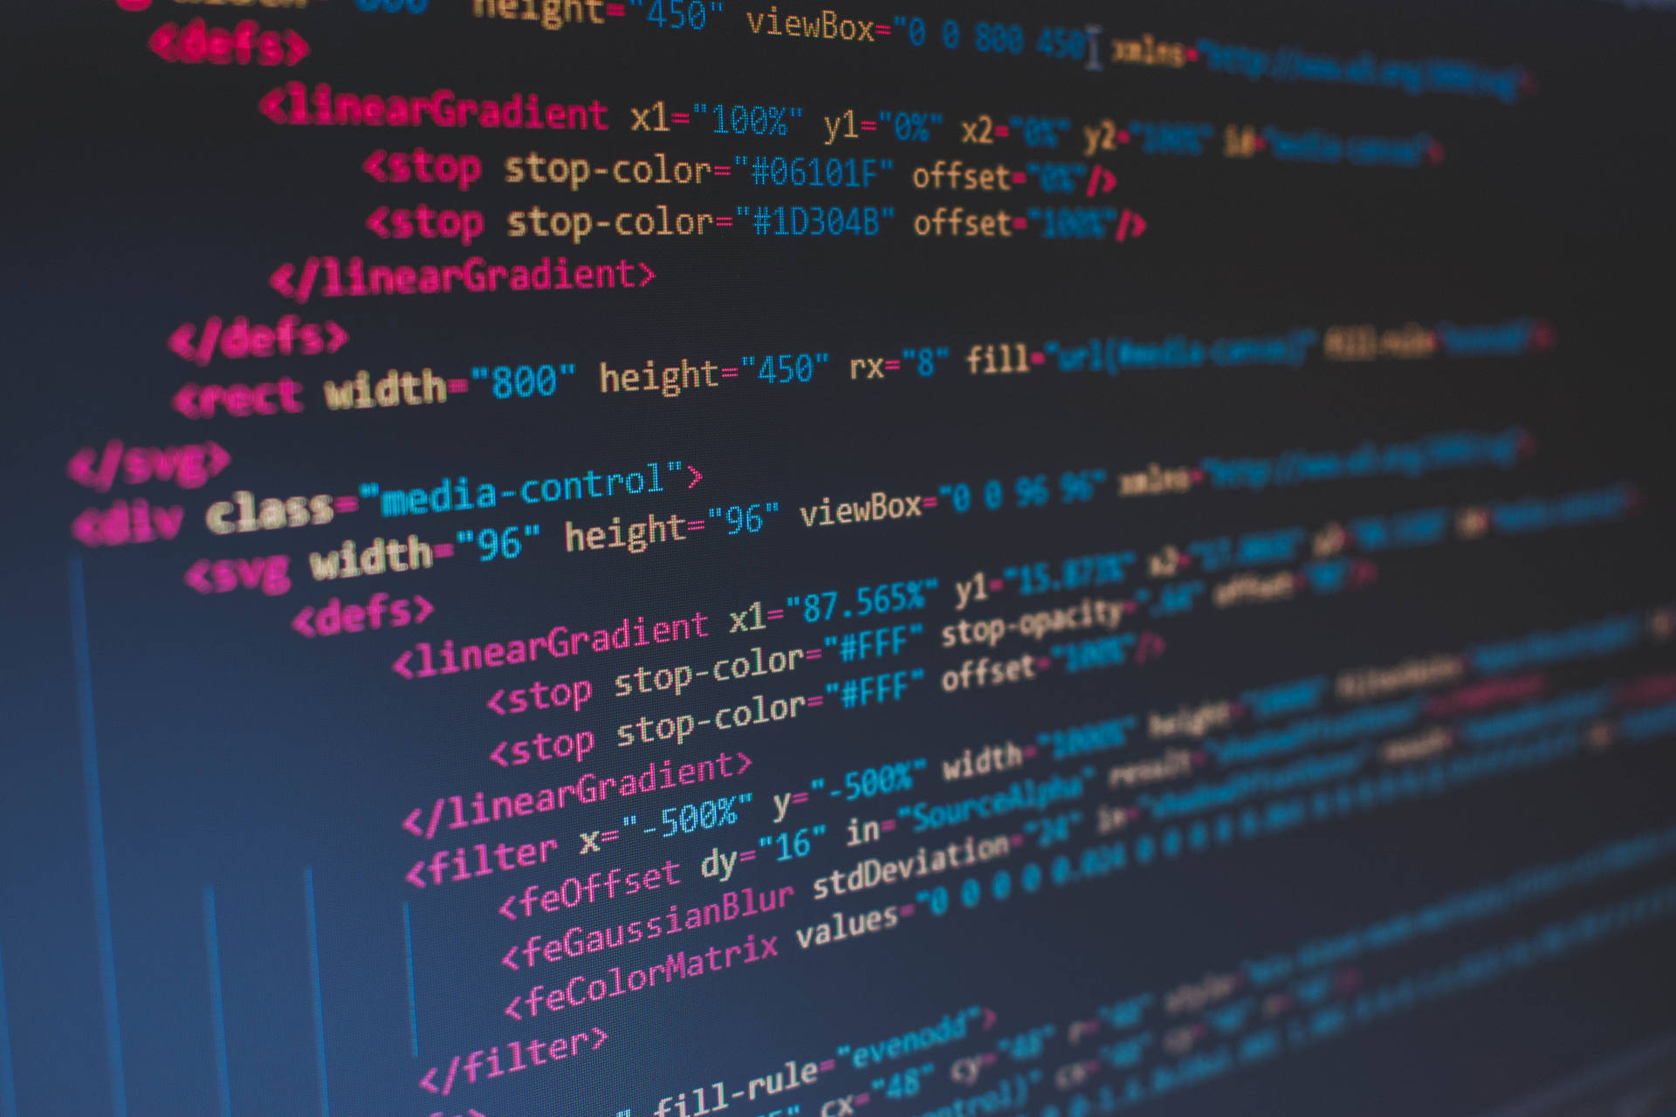
REGISTER FOR EVENT
To register for a event first we need to give the name of the event and then it will ask for the name for confirm registration.

Slide 10
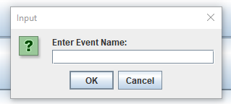
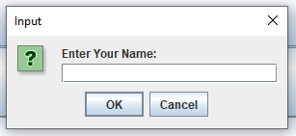
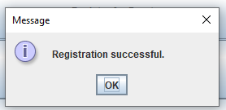
REGISTER FOR EVENT

Slide 11

EVENT INFO
We have to input the name of event. Then it will show all the info like event name, date, capacity, attendees and also the name of the attendees.

Slide 12
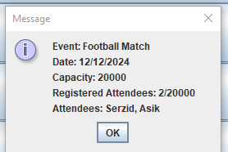
EVENT INFO

Slide 13
LIMITATIONS
Maintainability

Slide 14

In conclusion, the Event Management System simplifies the complexities of organizing events by offering a centralized and efficient solution. It enhances productivity, ensures better coordination, and provides a seamless experience for users. This system is a valuable tool for managing events of all scales, promoting efficiency and success in event planning.

Slide 15
THANK YOU

